Slide 1
A Study on Biodiversity for National Parks
Analyses and recommendations
by louie Yu

Slide 2
Species Information
What was observed in species_info.csv:
The DataFrame included the category of the species, their scientific names, common names, and conservation status.
The categories of specimens include mammal, bird, reptile, amphibian, fish, and vascular and nonvascular plants.
Total of 5,541 different species are recorded, both animals and plants.

Slide 3
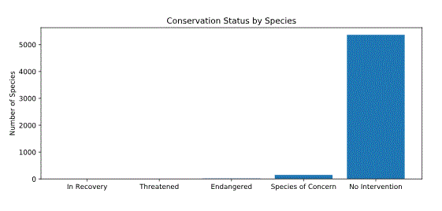
No. of Species Plotted Against Their Conservation Statues
From the bar chart, majority of species are in good hands; no intervention needed.
Most of the species that needed intervention are in “Species of Concern” category.

Slide 4
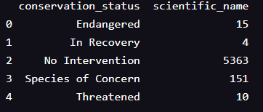
Observations from Species’ Conservation Statuses
Among them, approximately 3.2% of the species had concerns on their conservation statuses and needed interventions on their survival.
Among those needed interventions, 84% belonged to the category of “Species of Concern”.

Slide 5
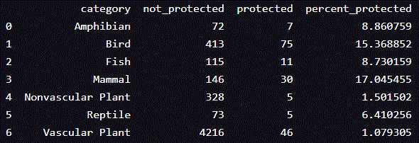
Observation of “% Protected” by Categories of Species
The numbers of “not_protected” species versus “protected” are shown in the table above. Percentages of those “protected” are calculated.
Among the species observed, Mammal and Bird had highest percentages of being “protected”.
The plants, both vascular and nonvascular, had lowest percentages.

Slide 6
Observing Significance of “Protected” Status between Species
Chi-Squared Test is utilized to perform significance comparisons.
The data were categorical with 2 pieces of data we are comparing.
Observation:
Between Mammal and Bird, though17% and 15% protected, respectively, the p-value was 0.69, which was much higher than commonly acceptable level of 0.05. Between them, one species was not significantly protected than one another.
However, when Chi-Squared Test performed between Mammal and Reptile, which are 17% and 6% protected, respectively, the p-value was 0.038, which was under the commonly acceptable level of 0.05. Reptile was significantly less protected comparing to Mammal.
Additional Chi-Squared Test was performed between Nonvascular and vascular plants. The p-value was 0.66. Their endanger statuses were not significant.

Slide 7
Conclusions after Completing Part 1 of the Biodiversity Analysis and a Recommendation
Certain types of species are more likely to be endangered than others.
From the Chi-Square Test between Mammal and Reptile, one concludes that Reptiles were less protected than Mammals. Therefore, more efforts should be put into protecting Reptiles.
No significance of endangerment observed between Nonvascular and Vascular plants.

Slide 8
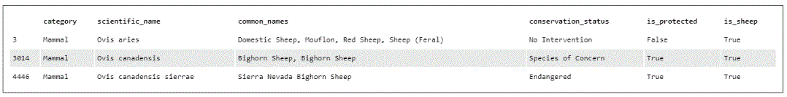
Observations of Sheep in Mammal
After extracting sheep information from Mammal, one observes that both Bighorn Sheep and Sierra Nevada Bighorn Sheep are in “Species of Concern” and “Endangered” conservation statuses, respectively.
Their whereabouts should be found in order to direct more efforts in their protections.

Slide 9
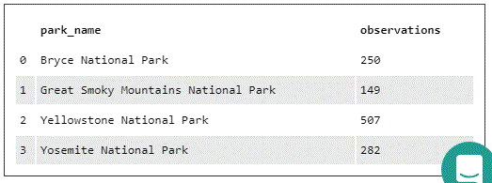
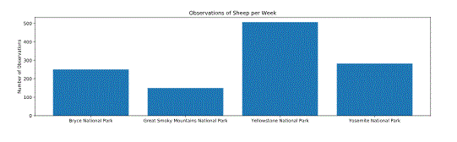
From the observation table and the plot, it is recommended that Yellowstone National Park has more sheep needed improvements in their conservation efforts.

Slide 10
Foot and Mouth Disease Reduction Effort
To help Park Rangers at Yellowstone National Park running a program to reduce the rate of foot and mouth disease, we observed:
From the record that 15% of sheep at Bryce National Park had the disease, the baseline conversation rate is set at 15%.
Park Rangers would like to detect at least 5% disease reduction. The minimum detectable effect is calculated as 33.3%.
Statistical Significance is set at 90% confidence interval.
Then, the sample size needed per variant was 870.
Therefore, to conduct the study at Yellowstone National Park, it would need about 2 weeks to complete the project.
For Bryce National Park, where there are less sheep observed, it would need about 3 and a half weeks.

